Slide 1
TCS-ICS: mapping metadata

Slide 2
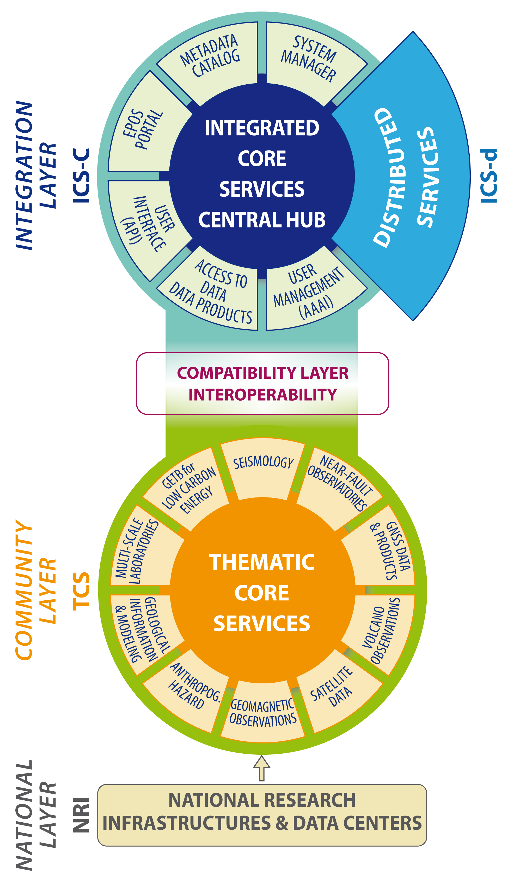
Architecture
Integrated Core Services
(ICS)
Interoperability layer
Thematic Core Services
(TCS)

Slide 3


CATALOG
METADATA EXCHANGE

Slide 4
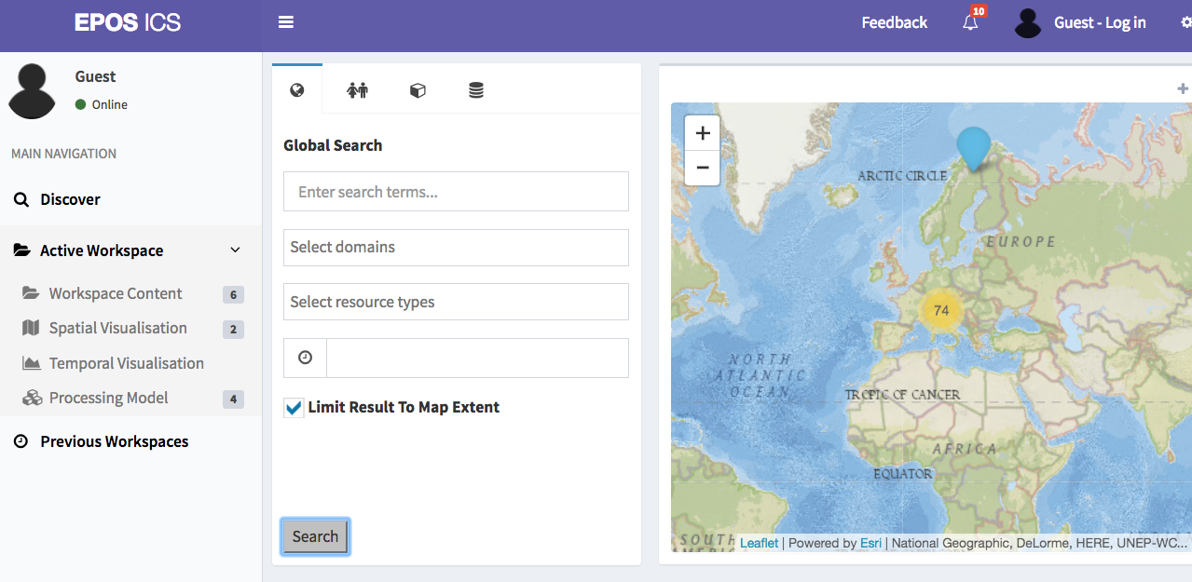
GUI
http://nodedev.bgs.ac.uk/epos/epos-gui/master/index.html

Slide 5
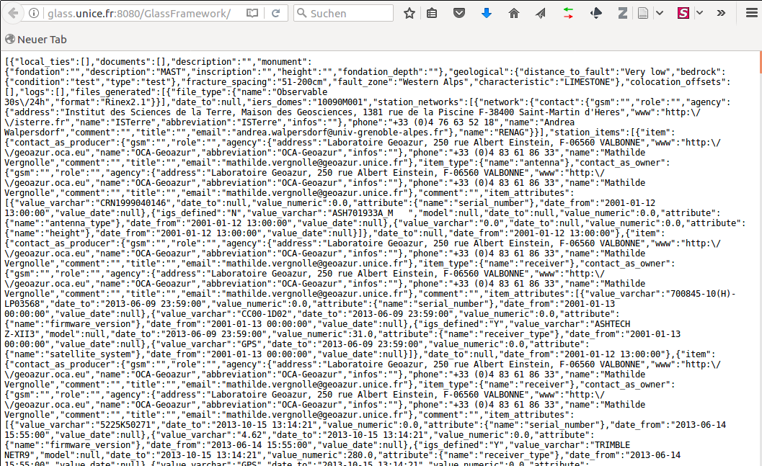
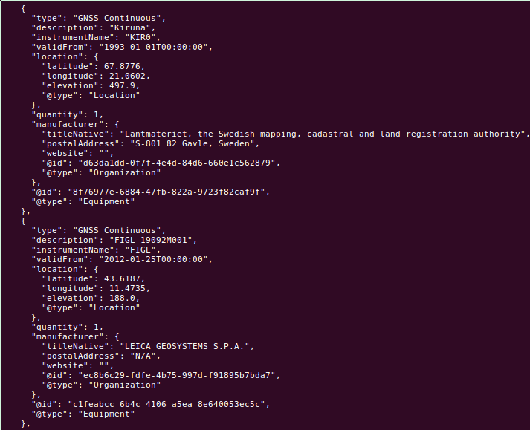
TCS
Web-Services Metadata
Convertor
MAPPER & INGESTOR
EPOS CATALOG
EPOS BASELINE
Mapper
Mapper
Community Webservice (e.g. GNSS stations)
Baseline serialisation
(e.g. EPOS-DCAT-AP)
CERIF E/R instance

Slide 6
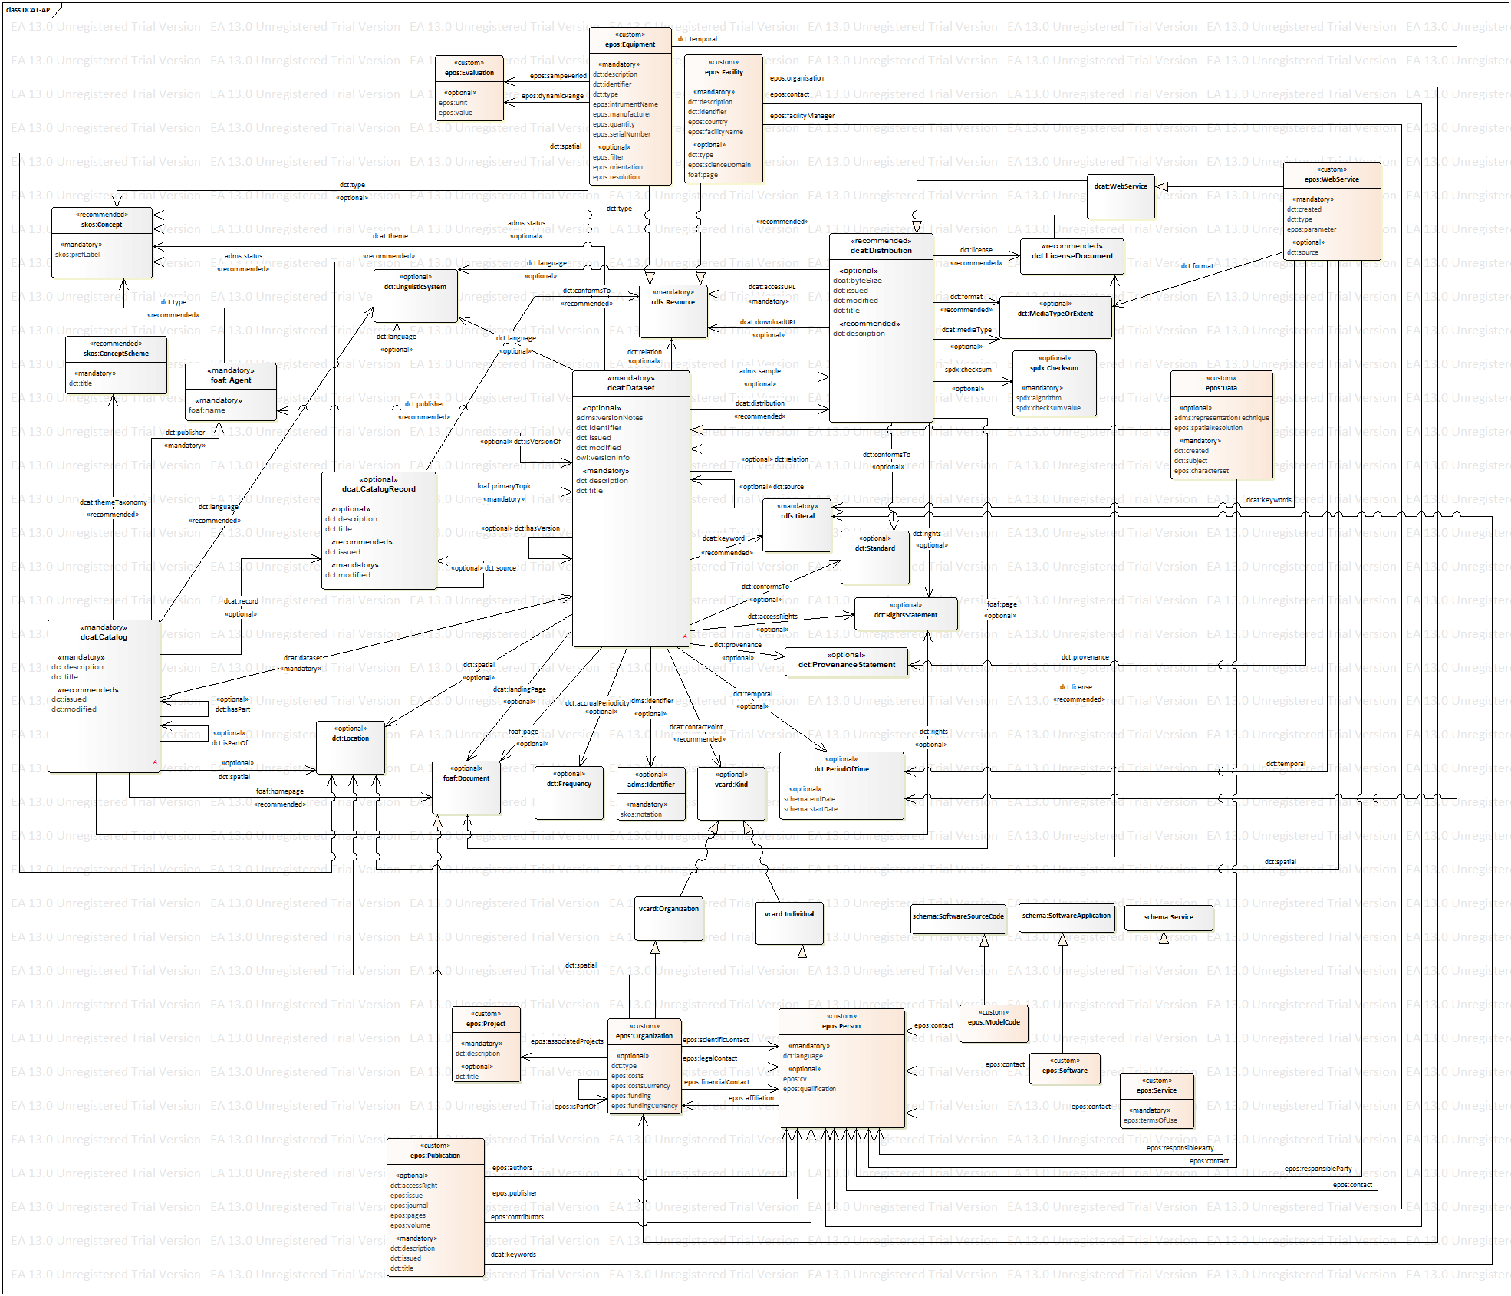
EPOS-DCAT-AP
Equipment
Facility
Webservice
Data
Organisation
Software
Publication
Person
Service

Slide 7
TCS Metadata→ EPOS-DCAT-AP
XML example
XML-Schema (.xsd)

Slide 8
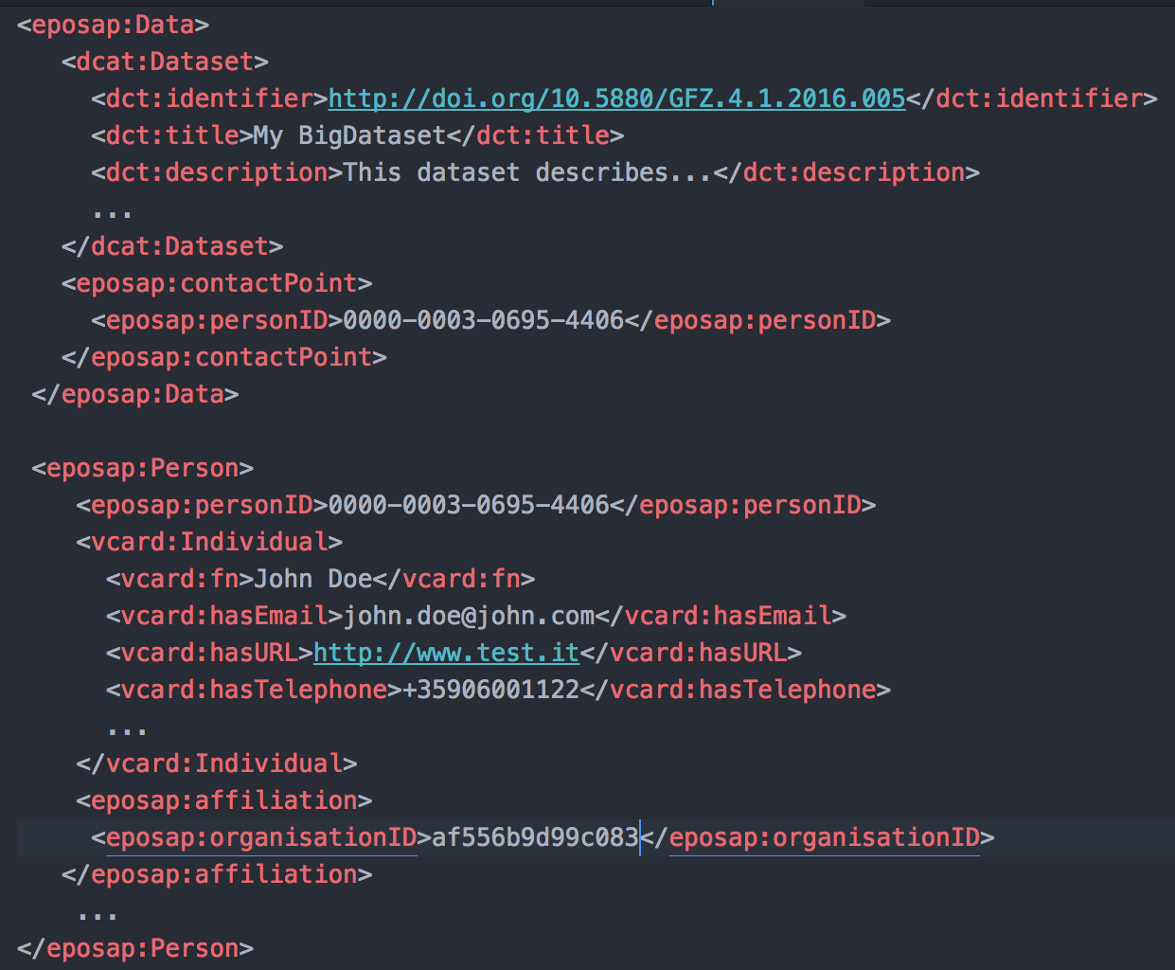
XML example
Linked concepts

Slide 9
TCS Metadata→ EPOS-DCAT-AP
Translate community metadata to the baseline
Payloads match and map
Mapping priorities
WebServices
Organisation
Person
Dataset
GUI http://nodedev.bgs.ac.uk/epos/epos-gui/master/index.html
Mapper

Slide 10
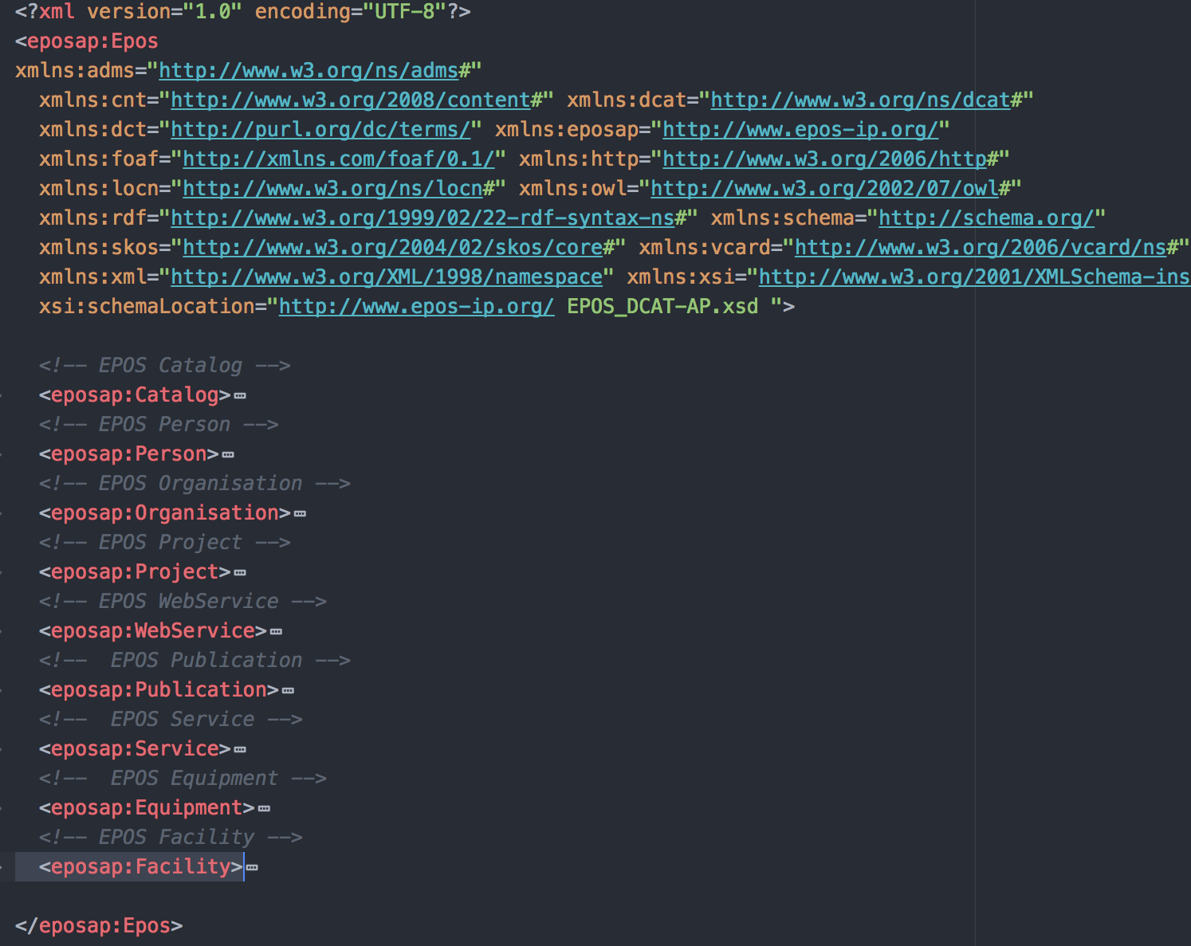
EPOS-DCAT-AP xml example

Slide 11
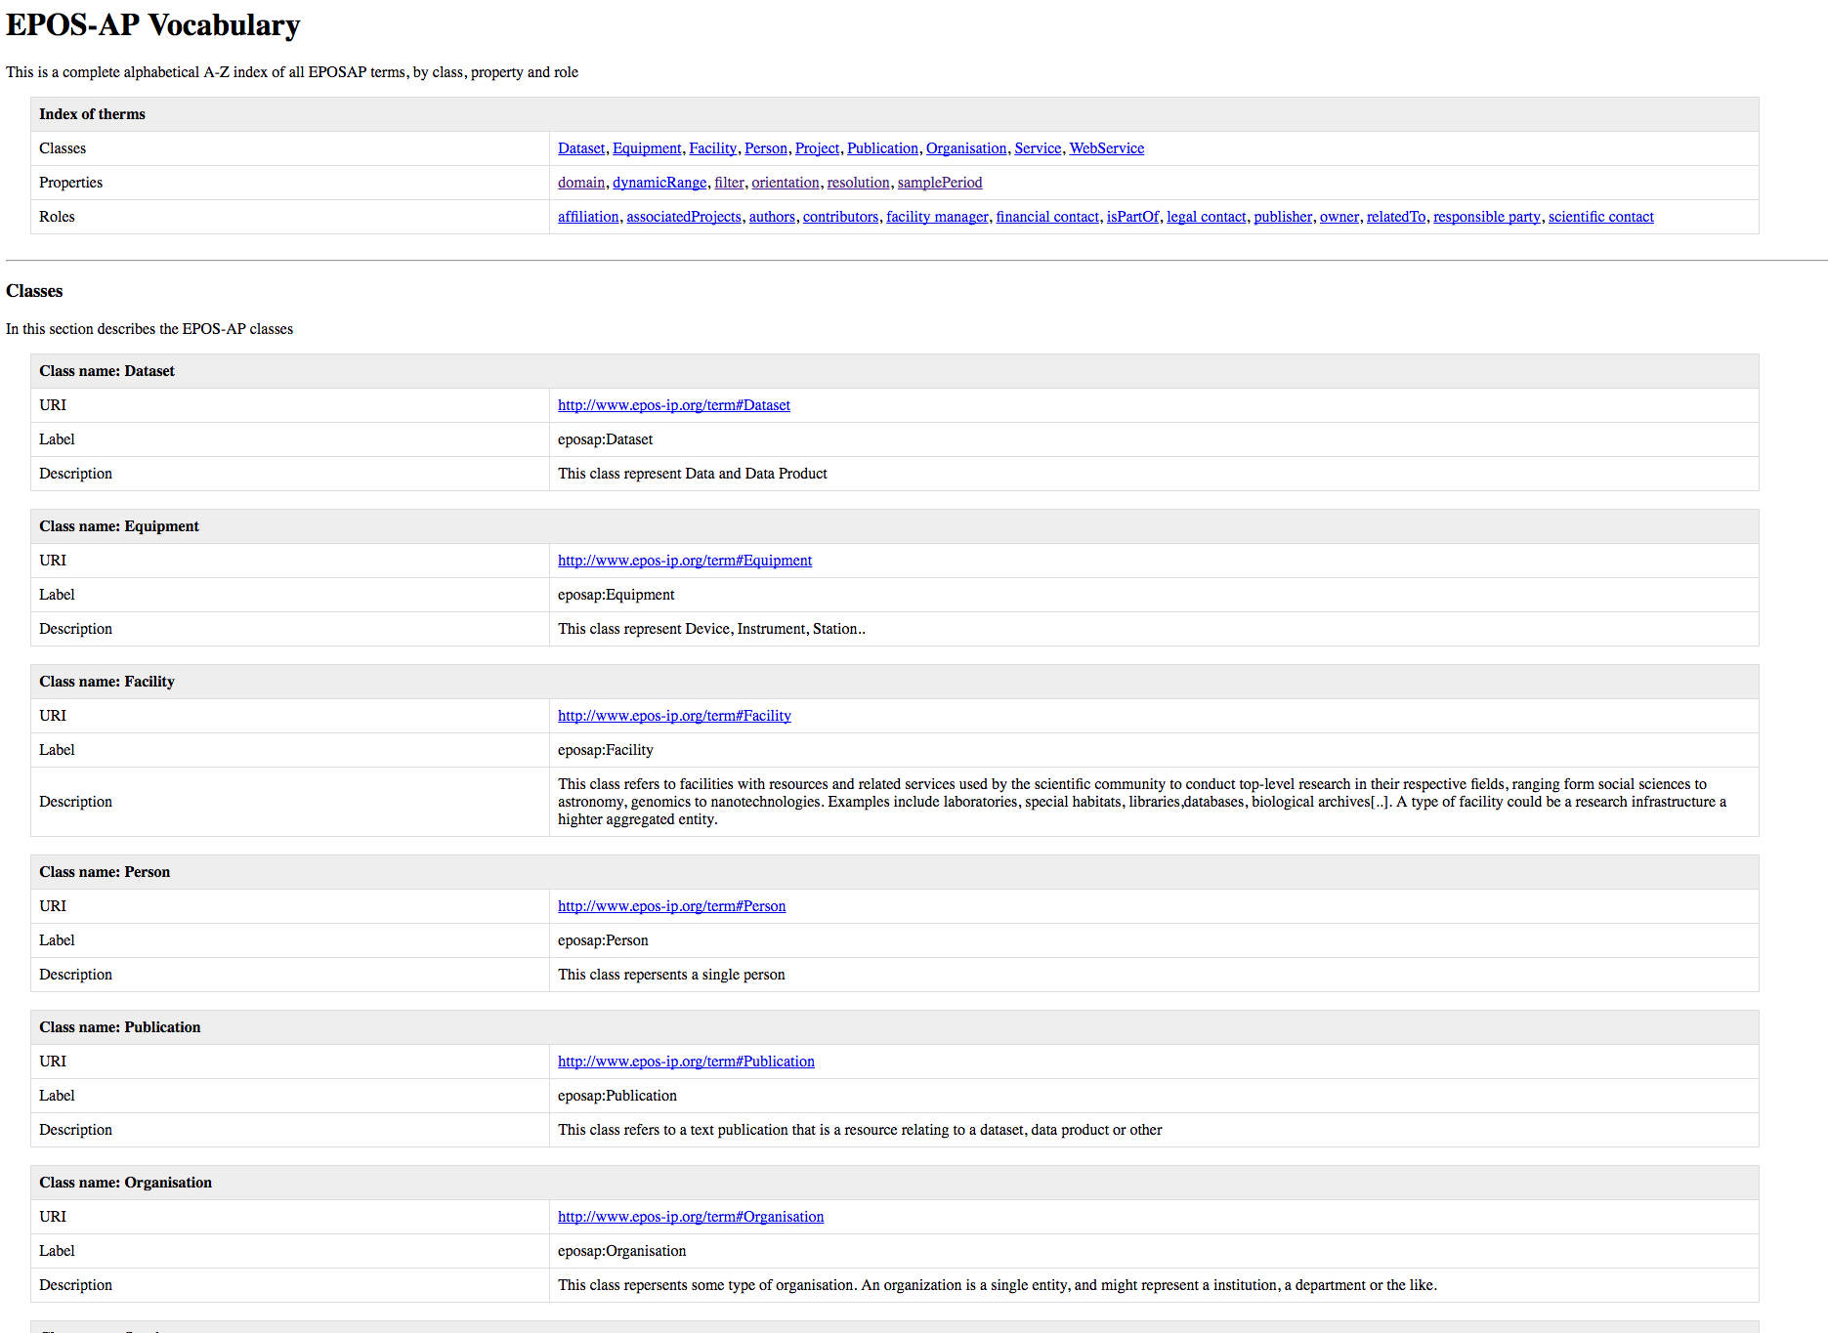
http://www.epos-ip.org/terms

Slide 12
Seismic stations example
STATIONS FROM IV NETWORK
http://webservices.rm.ingv.it/fdsnws/station/1/query?network=IV&level=station&includerestricted=true&format=xml&formatted=false&nodata=204&visibility=true
TCS STATION ->DCAT mapping xls

Slide 13
TODOs
Webservice examples of expected output

Slide 14
Tools
Github:
https://github.com/epos-eu/EPOS-DCAT-AP
xml mapping
jamper http://jamper.sourceforge.net/
https://www.altova.com/mapforce/xml-mapping.html
.xsd validation
https://www.w3schools.com/xml/xml_validator.asp
http://www.utilities-online.info/xsdvalidation/#.WTazCRPygkg

Slide 15
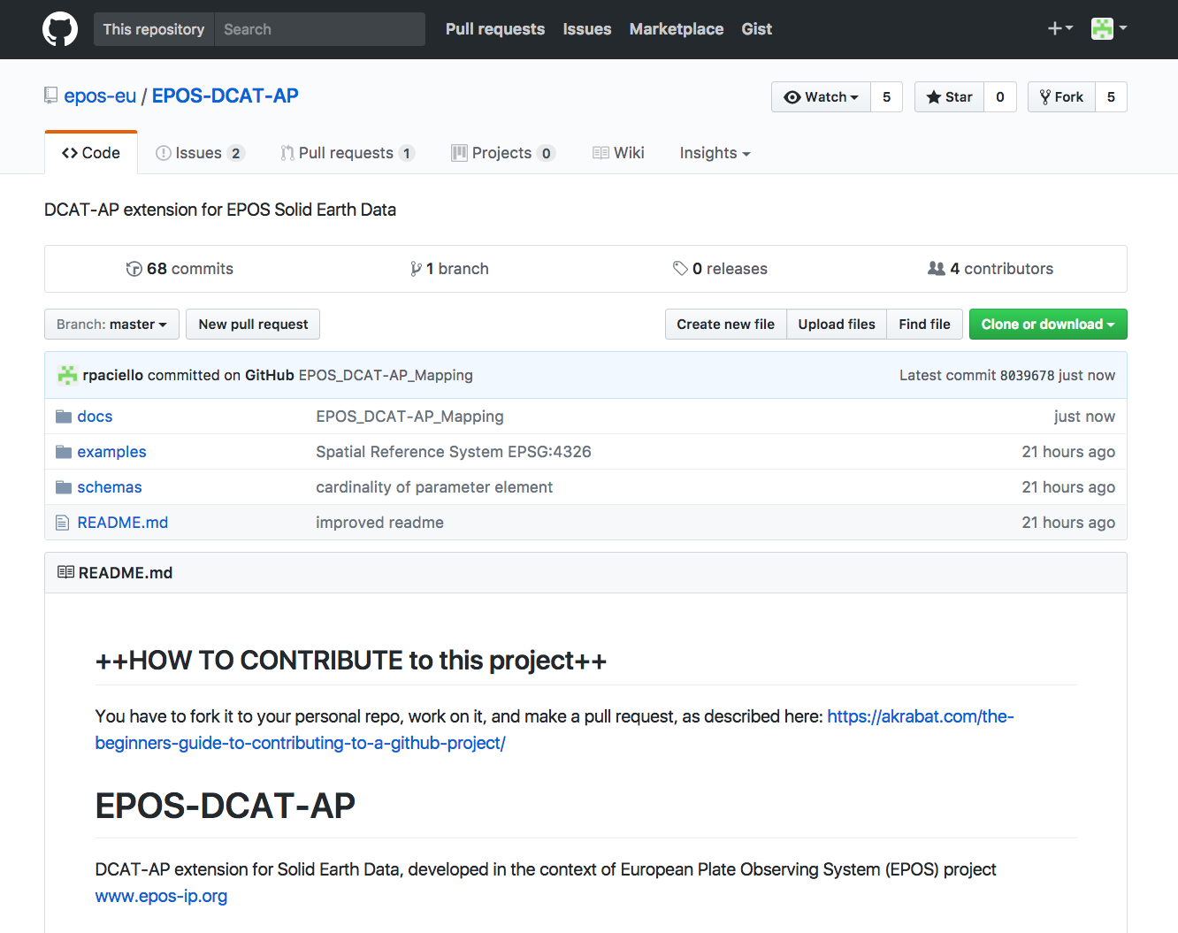
GitHub Repository

Slide 16
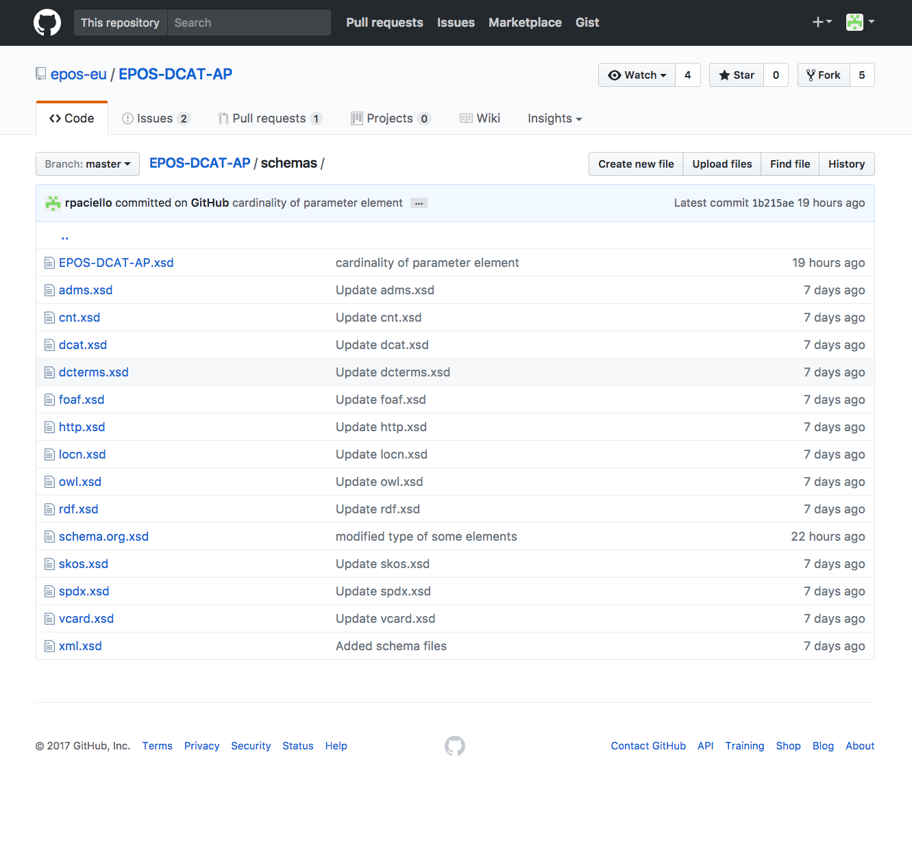
<xs:element name="WebService" type="eposap:WebService" />
<xs:complexType name="WebService">
<xs:sequence>
<!-- dcat:Distribution properties -->
<xs:element ref="dct:title" minOccurs="1" maxOccurs="unbounded" />
<xs:element ref="dct:description" minOccurs="1" maxOccurs="unbounded" />
<xs:element ref="dct:issued" minOccurs="1" maxOccurs="1" />
<xs:element ref="dct:modified" minOccurs="1" maxOccurs="1" />
<xs:element ref="dct:license" minOccurs="1" maxOccurs="unbounded" />
<xs:element ref="foaf:page" minOccurs="1" maxOccurs="1" />
<xs:element ref="dct:format" minOccurs="0" maxOccurs="1" />
<xs:element ref="dct:rights" minOccurs="0" maxOccurs="unbounded" />
<xs:element ref="dct:conformsTo" minOccurs="0" maxOccurs="1" />
<!-- EPOS extension -->
<xs:element ref="dct:identifier" minOccurs="1" maxOccurs="1" />
<xs:element ref="dct:created" minOccurs="1" maxOccurs="1" />
<xs:element name="domain" type="xs:string" minOccurs="1" maxOccurs="1" /><!-- domain -->
<xs:element ref="dct:type" minOccurs="1" maxOccurs="1" /><!-- resource type -->
<xs:element ref="dcat:keyword" minOccurs="1" maxOccurs="unbounded" />
<xs:element name="parameter" minOccurs="0" maxOccurs="unbounded">
<xs:complexType>
<xs:sequence>
<xs:element ref="http:paramName" minOccurs="1" maxOccurs="1" />
<xs:element ref="dct:type" minOccurs="1" maxOccurs="1" /> <!-- parameter type -->
<xs:element ref="http:paramValue" minOccurs="0" maxOccurs="1" />
<xs:element ref="owl:versionInfo" minOccurs="0" maxOccurs="1" />
</xs:sequence>
</xs:complexType>
</xs:element>
<xs:element ref="dcat:contactPoint" minOccurs="1" maxOccurs="1" />
<xs:element ref="eposap:responsibleParty" minOccurs="1" maxOccurs="1" />
<xs:element ref="dct:spatial" minOccurs="0" maxOccurs="1" />
<xs:element ref="adms:representationTechnique" minOccurs="0" maxOccurs="1" />
<xs:element ref="dct:temporal" minOccurs="0" maxOccurs="1" />
<xs:element ref="dct:provenance" minOccurs="0" maxOccurs="1" />
<xs:element ref="dct:source" minOccurs="0" maxOccurs="1" />
</xs:sequence>
</xs:complexType>
schemas folder contains:
EPOS-DCAT-AP.xsd
other vocabularies XML schema definitions
EPOS-DCAT-AP.xsd

Slide 17
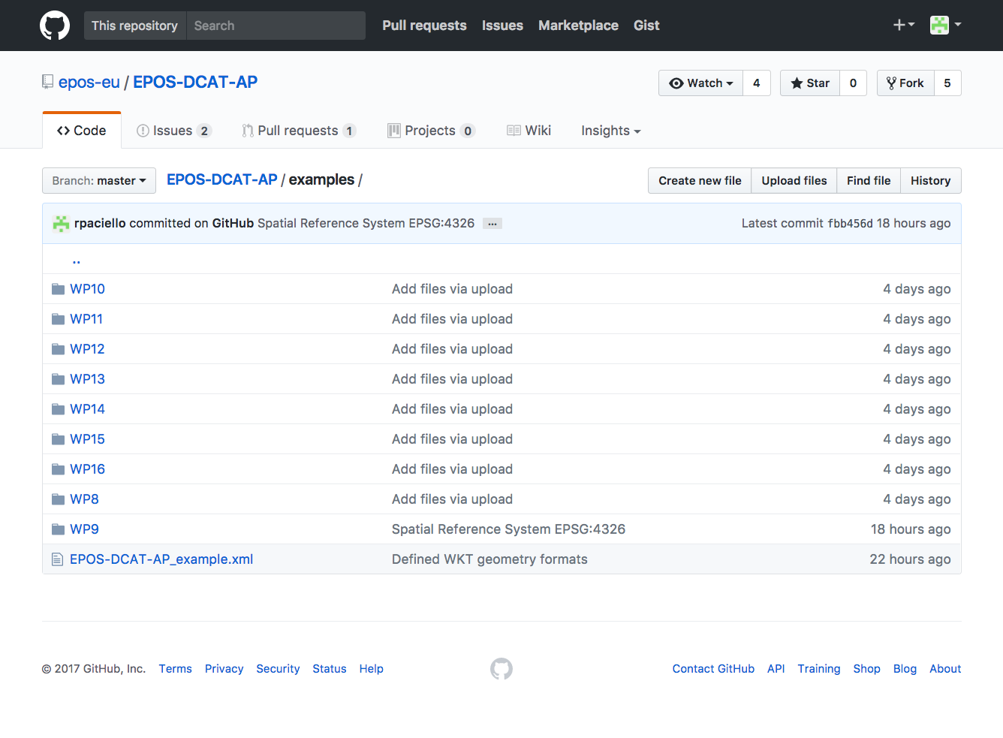
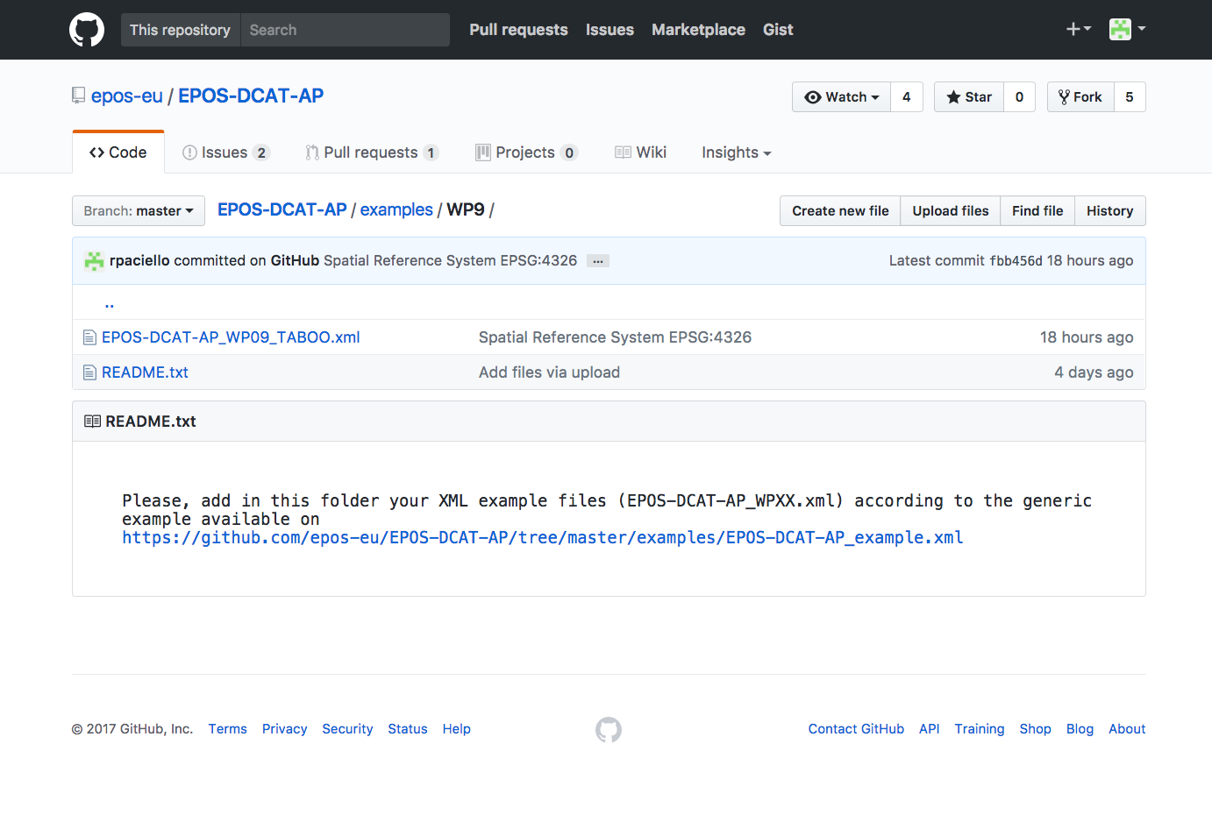
examples folder contains a number of mapped metadata examples from EPOS communities

Slide 18
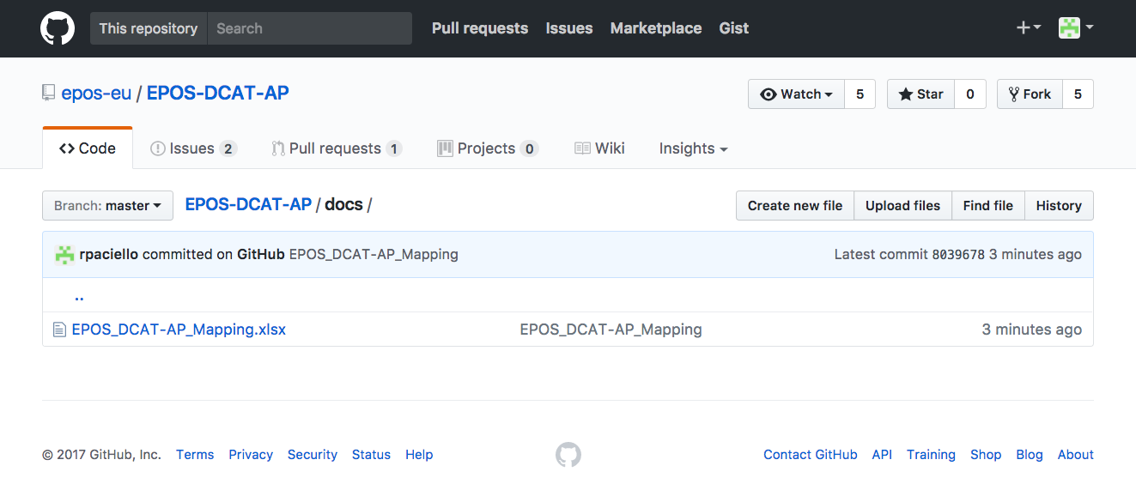
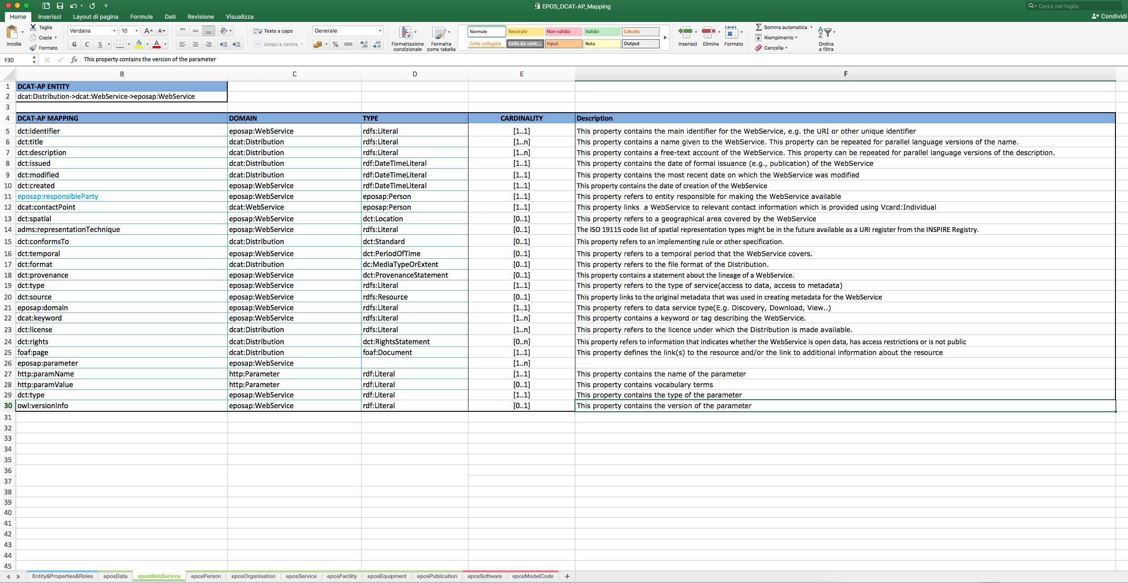
EPOS_DCAT-AP_Mapping.xlsx

Slide 19
Q&A
What kind of services you have?
Can you provide details?
Do you provide metadata (xml, json?), binary files, or WMS as output?
AOB
General guidelines http://wiki.epos-ip.org/index.php/TCS_Metadata_Mapping

